Slide 1
Decision making in IVF: leveraging novel technologies
Supervised by:
Professor Bahlol Rahimi
Student:
Hajar Abbassi
2025/12/29

Slide 2
Contents
Infertility
Assisted reproductive technologies (ART)
In vitro fertilization (IVF)
Key decisions
Clinical decision support systems (CDSS)
Implementation of CDSS
Challenges and limitations
Articles
1

Slide 3

Infertility
WHO definition
a disease of the male or female reproductive system characterized by the failure to
achieve pregnancy after 12 months or more of regular unprotected sexual intercourse.
Ranked as the eighth most severe disability globally, infertility affects one in every six individuals at some point in their lives.
According to the World Report on Disability (2011), 32.5 million people of reproductive age in low- and middle-income countries suffer from infertility issues.
In the United States, the prevalence of infertility is 8.8% (National Center for Health Statistics, 2020).
In the United Kingdom, the prevalence of infertility was 12.5% in women and 10.1% in men.
1) A deep learning approach to understanding controlled ovarian stimulation and in vitro fertilization dynamics/ Jia Wang, Zitao Liu1, Chenxi Zhang, Scientific Reports | (2025) 15:7821
2) Predicting clinical pregnancy using clinical features and machine learning algorithms in in vitro fertilization/ Cheng-WeiWang, Chao-YangKuo, PLOSONE, June 8, 2022
2

Slide 4





Assisted Reproductive Technology (ART)
In Vitro Fertilization (IVF):
Fertilization occurs outside the body, and the resulting embryo is transferred into the uterus.
Intracytoplasmic Sperm Injection (ICSI):
A single sperm is directly injected into an egg to achieve fertilization.
Gamete Intrafallopian Transfer (GIFT):
Eggs and sperm are placed directly into the fallopian tube for fertilization.
Zygote Intrafallopian Transfer (ZIFT):
A fertilized egg (zygote) is transferred into the fallopian tube.
Donor Programs:
Use of donated sperm, eggs, or embryos when patients cannot use their own.
3
3) Assisted reproductive technologies (ARTs): Evaluation of evidence to support public policy development /Alexa A Nardelli1, Tania Stafinski, Reproductive Health 2014
4) Artificial intelligence-driven precision treatment of reproductive medicine-related diseases :the optimal protocol choice for IVF-ET LiWena,b,g,1,DiWu, Journal of Advanced Research 2025

Slide 5







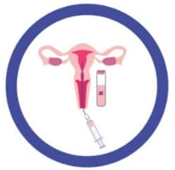
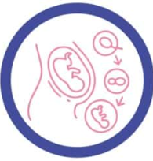
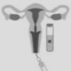
In vitro fertilization
1: Ovarian Stimulation
2: Monitoring
3: Oocyte Retrieval
4: Sperm Collection
5: Fertilization
9: Pregnancy Test
8: Luteal Phase Support
7: Embryo Transfer
6: Embryo development
5) Assisted Reproductive Technology (ART) Techniques /Meaghan Jain ;book
6) Artificial intelligence-driven precision treatment of reproductive medicine-related diseases :the optimal protocol choice for IVF-ET LiWena,b,g,1,DiWu, Journal of Advanced Research 2025
4

Slide 6

Key decisions
Decisions on the Day of Oocyte Pickup (OPU)
Patient Selection and Indication for IVF
Embryology Laboratory Decisions
Selection of Controlled Ovarian Stimulation (COS) Protocol
Timing and Method of Embryo Transfer
Dose Adjustment During Stimulation/ Trigger Timing and Type
7) The dilemma of the trigger timing in IVF: a review /Hassan Maghraby, Hesham Saleh, Middle East Fertility Society Journal 2024
8) Artificial intelligence in invitro fertilization :a computer decision support system for day-to-day management of ovarian stimulation during in vitro fertilization Gerard Letterie ,M.D.,a and Andrew MacDonald, Fertility and Sterility2020
5

Slide 7

Clinical decision support systems (CDSS)
Decision Support System (DSS)
a computer-based system that integrates data, models, and expert knowledge to help users make complex or semi-structured decisions more effectively and informedly.
Clinical decision support systems (CDSS) are computer systems designed to impact clinician decision making about individual patients at the point in time that these decisions are made.
management and organizational sciences
supported retrospective analyses of financial and administrative data
9) Eta S. Berner Editor Clinical Decision Support Systems Theory and Practice Third Edition, book, Eta S. Berner Editor
10) Evaluating informatics applications—clinical decision support systems literature review Bonnie Kaplan , International Journal of Medical Informatics 64 (2001)
11) Application of Decision Support Systems to Water Management: The Case of Iraq Hayder AL-Hudaib 1,*, Nasrat Adamo, Water 2025, 17, 1748
6

Slide 8


Main Classification of CDSS
Knowledge-Based CDSS
Non–Knowledge-Based CDSS
These systems rely on explicit medical knowledge, such as clinical guidelines, rules, and expert-defined logic.
These systems use statistical models, machine learning algorithms, and data- driven approaches to generate recommendations based on patterns learned from clinical data.
12) Eta S. Berner Editor Clinical Decision Support Systems Theory and Practice Third Edition, book, Eta S. Berner Editor
7

Slide 9



Knowledge-Based CDSS
Three parts of the CDSS
Examples of CDSS
Well-known CDSS implementations
Diagnostic Decision Support
Systems
Alerting and Reminder
Systems
Guideline-Based Decision
Support Systems
Knowledge Base
Inference Engine
Communication mechanism
MYCIN
DX plain
12) Eta S. Berner Editor Clinical Decision Support Systems Theory and Practice Third Edition, book, Eta S. Berner Editor
13) An overview of clinical decision support systems: benefits, risks, and strategies for success Reed T. Sutton 1 , David Pincock, npj Digital Medicine (2020) 3:17
8

Slide 10

Nonknowledge-Based CDSS
Data Acquisition / Input Module
Data Preprocessing Module
Feature Extraction / Engineering Module
Modeling / Learning Module
Prediction / Decision Module
Evaluation / Feedback Module
User Interface / Reporting Module
Predictive System
Image Analysis / Computer Vision
Disease Progression Prediction
Personalized Treatment systems
Parts of the CDSS
Examples of CDSS
IBM Watson for Oncology, DeepMind Health, Arterys, Aidoc, PathAI
12) Eta S. Berner Editor Clinical Decision Support Systems Theory and Practice Third Edition, book, Eta S. Berner Editor
14) XAI-Based Clinical Decision Support Systems: A Systematic Review Se Young Kim1 ,DaeHoKim2,MinJiKim, Appl. Sci. 2024, 14, 6638.
15) Effects of machine learning-based clinical decision support systems on decision-making, care delivery, and patient outcomes: a scoping review Anindya Pradipta Susanto/AMIA,2023
9

Slide 11
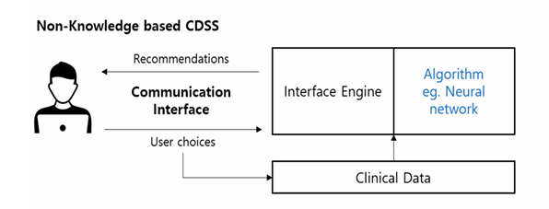
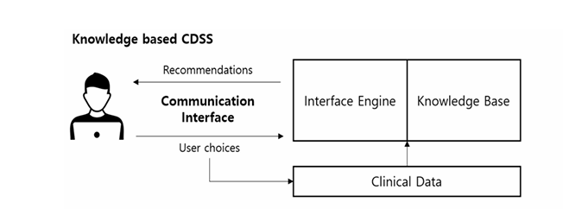
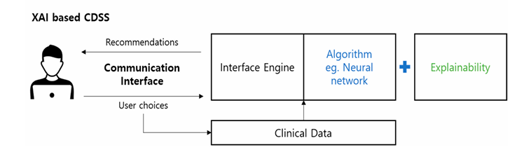
XAI-based Based CDSS
XAI-based clinical decision support systems use AI models to analyze patient data while providing human-understandable explanations for their predictions or recommendations. This enhances transparency, trust, and adoption in clinical practice.
12) Eta S. Berner Editor Clinical Decision Support Systems Theory and Practice Third Edition, book, Eta S. Berner Editor
14) XAI-Based Clinical Decision Support Systems: A Systematic Review Se Young Kim1 ,DaeHoKim2,MinJiKim, Appl. Sci. 2024, 14, 6638.
15) Effects of machine learning-based clinical decision support systems on decision-making, care delivery, and patient outcomes: a scoping review Anindya Pradipta Susanto/AMIA,2023
10

Slide 12
Additional Classifications of CDSS
CDSS Based on Degree of Clinical Intervention
CDSS Based on Integration with Clinical Systems
Passive CDSS
The system does not automatically
provide alerts or recommendations.
Standalone CDSS
The system operates independently of
clinical systems and requires manual data
entry.
Active CDSS
The system automatically intervenes
without user request.
Integrated CDSS
The system is integrated with clinical
systems, including EHR, CPOE, and HIS.
12) Eta S. Berner Editor Clinical Decision Support Systems Theory and Practice Third Edition, book, Eta S. Berner Editor
11

Slide 13
Implementation of (CDSS)
Knowledge Synthesis
Knowledge Formalization
Knowledge Localization
The process of combining the results of systematic review of the biomedical literature with the experience and expertise of experts to create recommendations about best practice.
Encompasses the activities in which formalized knowledge about appropriate care is introduced into the systems that influence care.
The process of translating narrative guidelines into structured knowledge that can be implemented consistently in CDS applications.
1
2
3
12) Eta S. Berner Editor Clinical Decision Support Systems Theory and Practice Third Edition, book, Eta S. Berner Editor
12

Slide 14
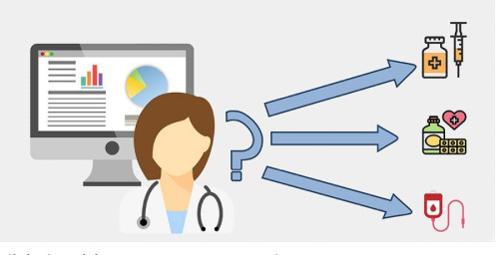
Challenges and limitations
Data Quality and Accuracy Heterogeneity of data
Integration with Clinical Workflow Integration with Existing Systems Data Privacy and Security
Low User Acceptance Alert Fatigue and Increased workload
Maintenance and Updating of Medical Knowledge
Cost and Resource Constraints
12) Eta S. Berner Editor Clinical Decision Support Systems Theory and Practice Third Edition, book, Eta S. Berner Editor
13) An overview of clinical decision support systems: benefits, risks, and strategies for success Reed T. Sutton 1 , David Pincock,digital medicine 2020
13

Slide 15
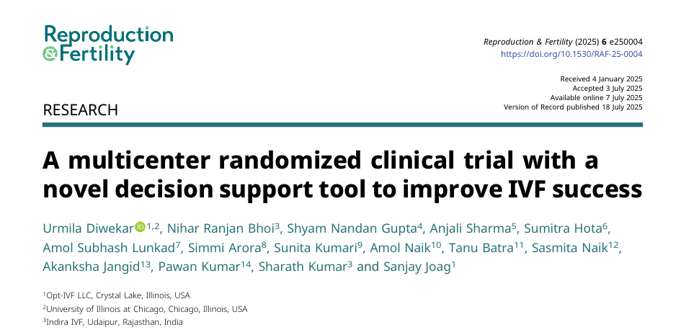
14

Slide 16
Purpose of the Study
The superovulation stage in IVF is the most expensive due to frequent ultrasounds and blood tests.
This clinical trial aims to study whether Opt-IVF improves clinical pregnancy rates across all patient types and protocols without any exceptions.
Hormone dosages are usually based on general guidelines and clinical experience, not individualized, which can sometimes cause overstimulation.
The Opt-IVF tool was developed to provide a personalized and optimized dosage for each patient, addressing these challenges.
15

Slide 17
Materials and methods
Initial Dosing of FSH
Prospective, multi-center, randomized, controlled clinical trial
Patients were numbered, and those with random numbers <0.5 were assigned to the Opt-IVF group, while those with ≥0.5 were assigned to the control group.
Opt-IVF determines the initial FSH dose using the La Marca & Sunkara nomogram, considering age, day 3 FSH, and AMH.
If FSH is unavailable, heuristics based on age, AMH, and antral follicle count (AFC) are used.
FSD data on day 1 and day 5 are collected via ultrasound, and an optimal control algorithm is used to determine the daily dose to maximize the number of mature follicles (18–21 mm).
Initial Dosing
12 Indira IVF centers in India
September 15, 2023, to April 15, 2024
16

Slide 18
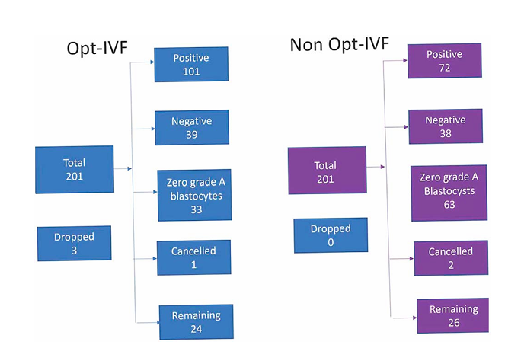
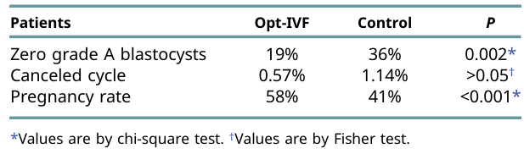
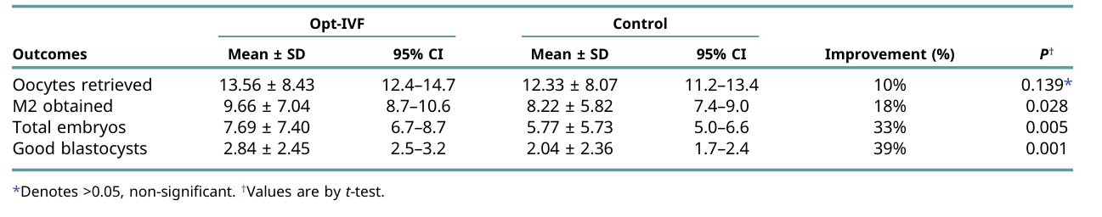
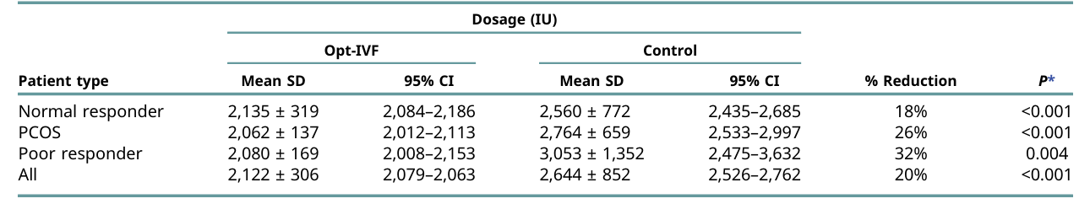
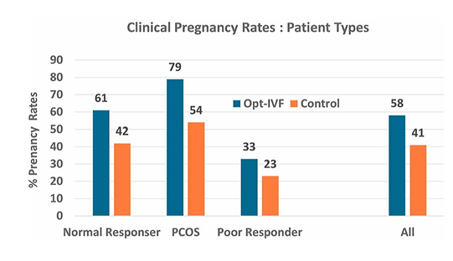
Results
17

Slide 19
Conclusion
01
02
03
04
Improved clinical outcomes with the use of the Opt-IVF decision support tool
Enhanced ovarian stimulation efficiency through reduced FSH dosage
Improved embryo quality via model-based personalized stimulation
A Cost-Effective, safe, and scalable approach for personalized IVF treatment
18

Slide 20
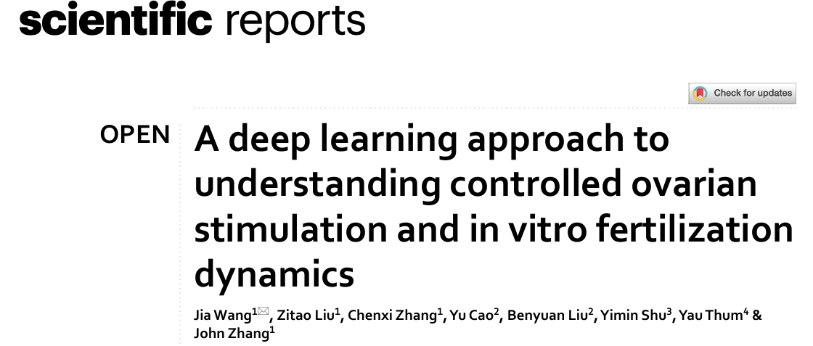
19

Slide 21
Purpose of the Study
Lack of modeling temporal and sequential dependencies across different stages of the IVF cycle.
To develop a Transformer-based deep learning model that captures IVF cycle dynamics and improves prediction accuracy of ovarian response and final treatment outcomes.
Low predictive accuracy for ovarian response and key outcomes such as mature oocyte (MII) count.
High complexity of clinical decision-making due to dynamic, multi-source data in IVF cycles.
20

Slide 22
Materials and methods
Initial Dosing of FSH
Clinical data were collected from 30,552 IVF cycles over approximately ten years at the New Hope Fertility Center (NHFC).
Edwards is a deep learning model based on a Transformer-Encoder architecture, designed to capture the temporal, dynamic, and sequential nature of IVF cycles.
Architecture: multi-layer Transformer Encoder.
A self-supervised pre-training strategy using Masked Language Modeling (MLM) was applied.
After pre-training, the model was fine-tuned for downstream IVF-specific tasks, including treatment planning and outcome prediction.
Initial Dosing
Each cycle included:
Patient demographic
information
Treatment regimens
Hormonal profiles
Follicular measurements
21

Slide 23
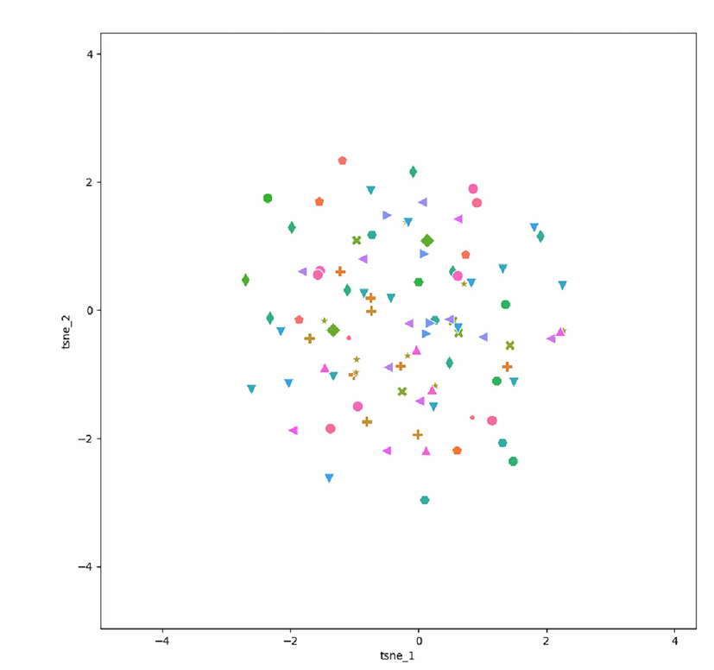
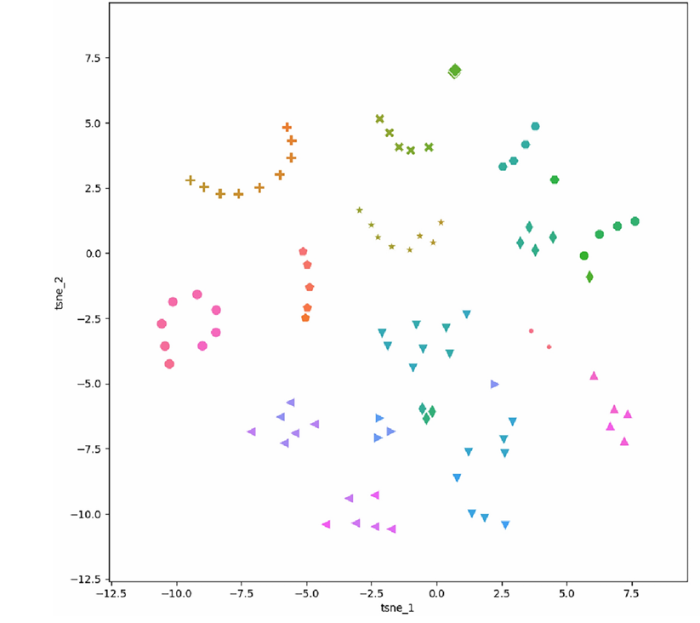
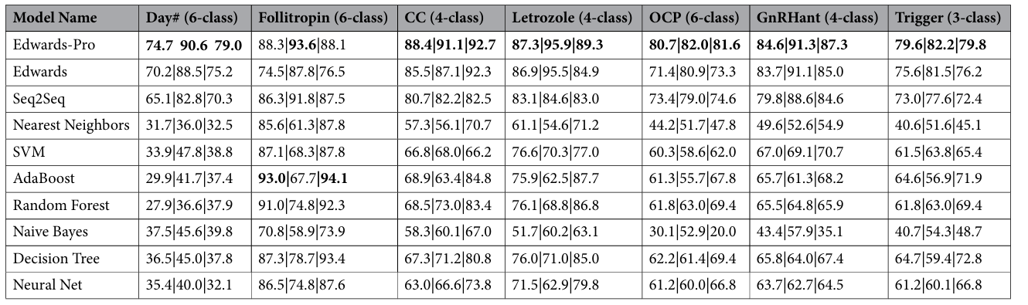
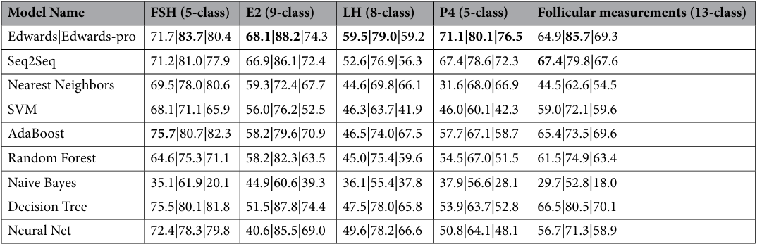
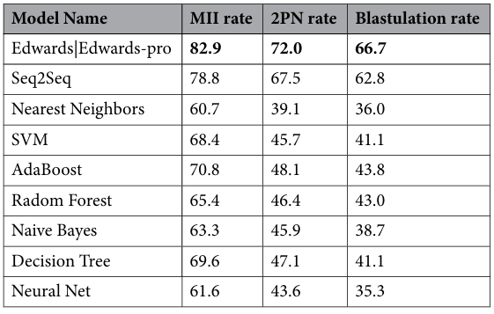
Results
model evaluation followed a two-phase strategy
Phase I: In-cycle COS Prediction
Phase II: Final IVF Outcome Prediction
22

Slide 24
Conclusion
01
02
03
04
Edwards is the first Transformer-based sequence learning model to comprehensively model nearly all key elements of the IVF cycle on a daily basis.
The model successfully learned the intrinsic relationships and dynamic endocrine mechanisms underlying controlled ovarian stimulation (COS).
This capability led to more accurate predictions both during the treatment cycle and for final IVF outcomes.
By integrating clinical knowledge, Edwards-Pro provides enhanced usability and practical value for clinicians.
23

Slide 25
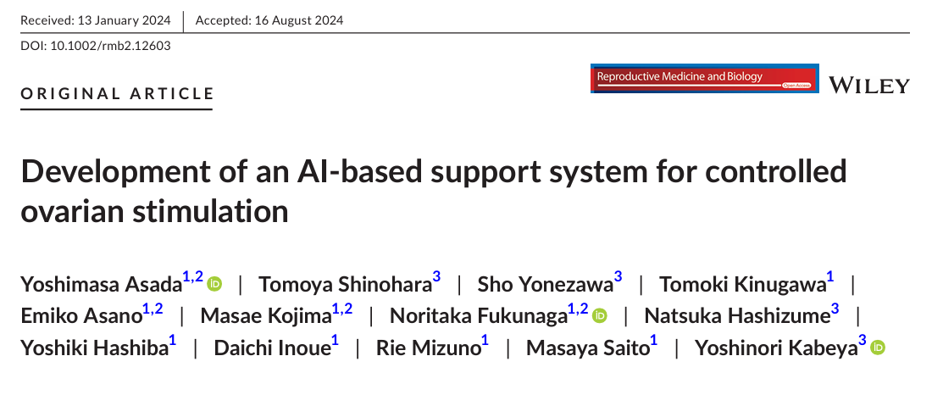
24

Slide 26
Purpose of the Study
Dependence of COS success on physician experience
Develop an AI-based decision support system for real-time COS management that improves decision consistency and reduces educational and supervisory burdens on clinicians.
Difficulty in transferring clinical knowledge to junior physicians
High supervisory and managerial workload for senior clinicians
25

Slide 27
Materials and methods
Initial Dosing of FSH
The AACS system had two models: oocyte retrieval and prescription inference, predicting optimal retrieval timing and appropriate medications.
Models were evaluated using Accuracy and AUC, and feature importance was calculated to aid interpretability.
Data from IVF Asada Ladies Clinic records, including follicles, hormones, age, and AMH, were collected and preprocessed for modeling.
Models were trained using LightGBM and evaluated with 5-fold cross-validation.
Data from June 2017 to November 2021 were used.
Initial Dosing
26

Slide 28
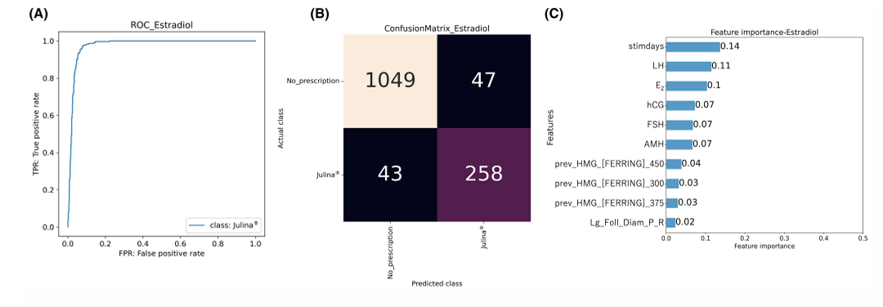
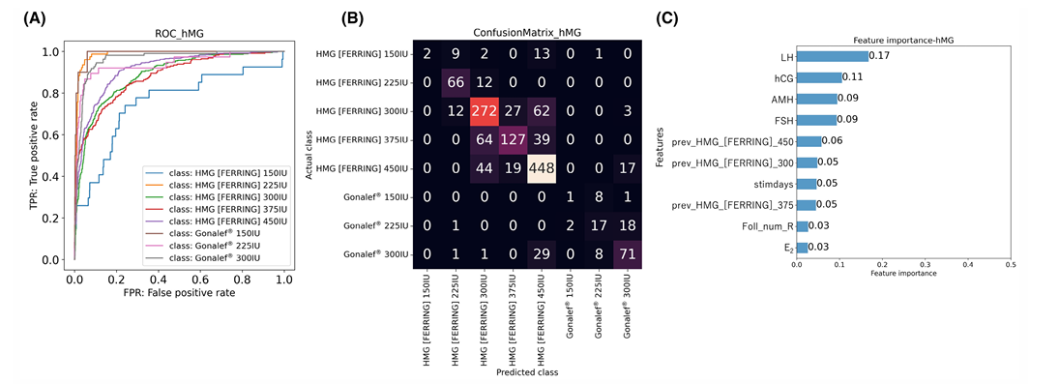
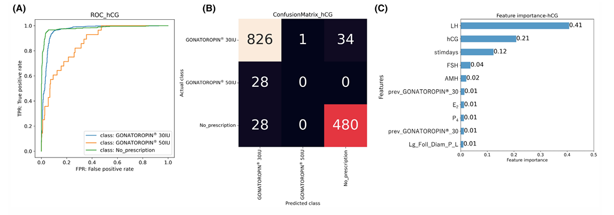
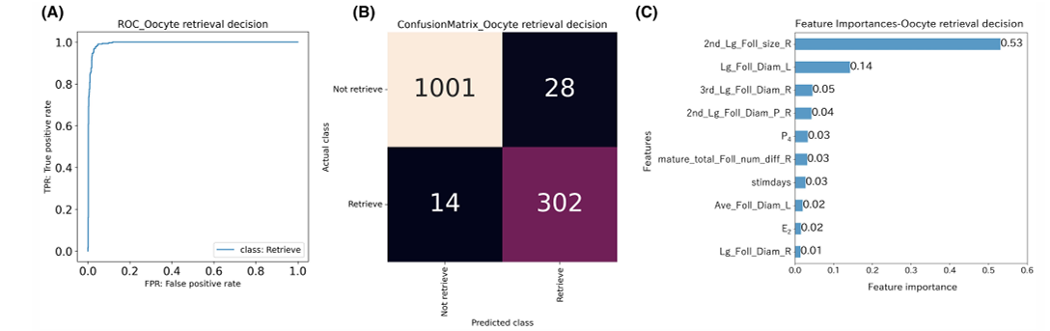
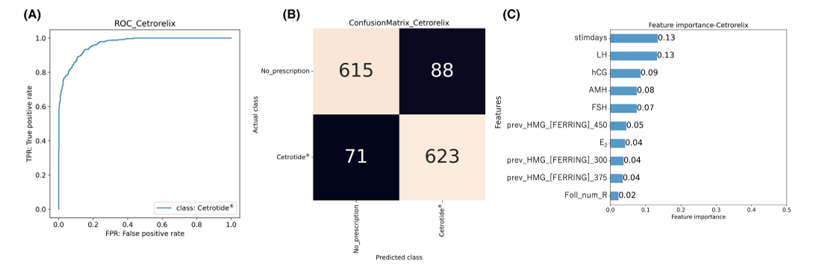
27

Slide 29
Conclusion
01
02
03
04
Oocyte Retrieval Decision Model:
AUC: 0.964
Accuracy: 96.9%
HMG: AUC 0.914, Accuracy 71.9%
HCG: AUC 0.937, Accuracy 93.5%
Cetrorelix: AUC 0.966, Accuracy 88.6%
Estradiol: AUC 0.976, Accuracy 93.6%
High accuracy and AUC: The models reliably predict oocyte retrieval timing and medication decisions.
Key clinical insights: Follicle size and hormone levels are the most important features guiding IVF treatment.
28

Slide 30
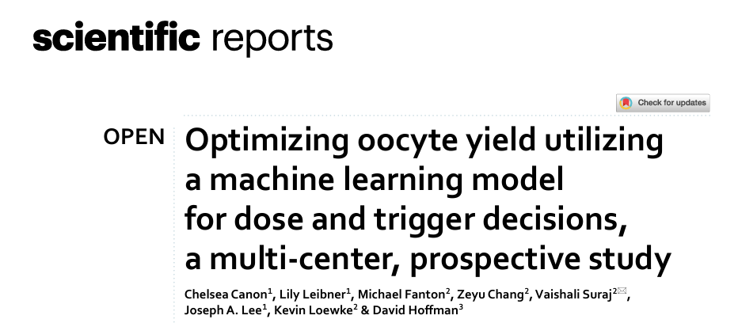
29

Slide 31
Purpose of the Study
Despite increasing use of AI in IVF, prospective clinical evidence demonstrating its effectiveness is limited.
To evaluate the effectiveness of Stim Assist, an AI-based clinical decision support platform, in optimizing the starting FSH dose and trigger injection timing to improve outcomes in IVF patients compared with historical control data.
Ovarian stimulation strategies vary among clinicians and centers, with no standardized approach, whereas AI can optimize clinical decisions safely.
Retrieving more mature oocytes increases the likelihood of producing euploid blastocysts and achieving live birth.
30

Slide 32
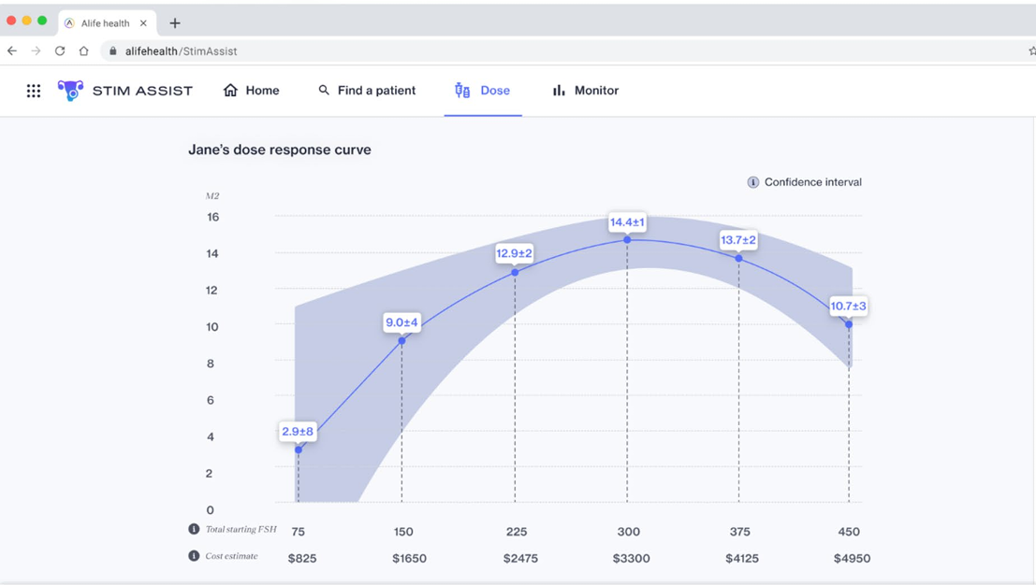
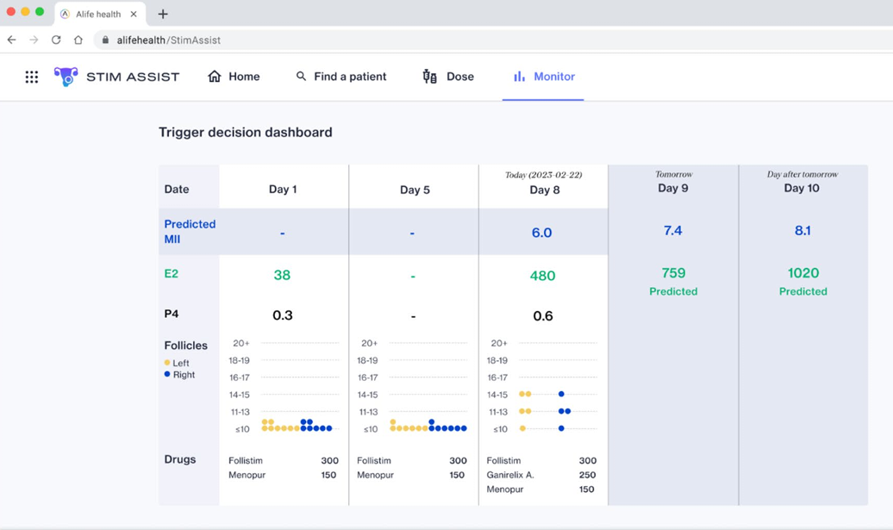
Materials and methods
Prospective, observational, post-market study. The treatment arm included 291 IVF patients using Stim Assist(2022,2023), and the control arm consisted of matched historical patients without Stim Assist(2021,2022).
Before prescribing the FSH dose, the physician reviews the Starting Dose tool’s dose–response curve to select the appropriate dose. During the cycle, the Trigger tool is used to determine the timing of trigger injection. . Physicians recorded whether the tool’s predictions confirmed, modified, or were ignored in their decisions.
re prescribing the FSH dose, the physician reviews the Starting Dose tool’s dose–response curve to select the appropriate dose. During the cycle, the Trigger tool is used to determine the timing of trigger injection.
Data for the treatment arm were directly entered into Stim Assist or EMR, while control arm data were extracted anonymously from EMR. Key data included the number of MII oocytes, total oocytes, age, BMI, AMH, AFC, cycle length, daily follicle size, and daily medications.
One-to-one matching between treatment and control patients was performed based on age, baseline AMH, and baseline AFC for each physician.
Initial Dosing of FSH
Initial Dosing
31

Slide 33
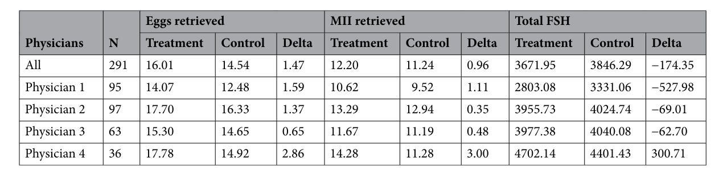
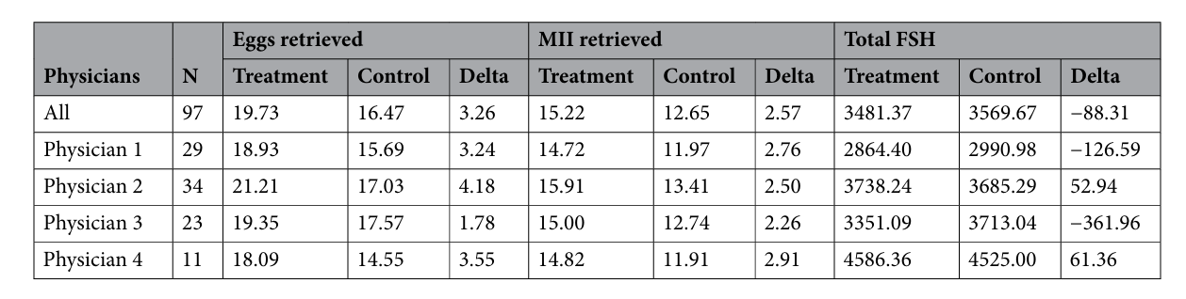
Results
36

Slide 34
Conclusion
01
02
03
04
Use of Stim Assist led to increased MIIs and total oocytes, but most of these improvements were not statistically significant.
The tool can help standardize starting dose and trigger timing decisions, reduce cognitive load for physicians, and assist non-specialists or trainees.
Total FSH consumption decreased, but the change was not statistically significant.
The trigger day was slightly longer, which may have contributed to the increased MIIs.
Stim Assist was safe, with no serious adverse events or OHSS reported.
32

Slide 35
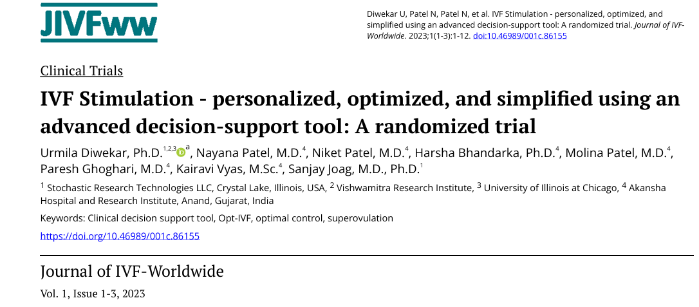
33

Slide 36
Purpose of the Study
Non-optimized, experience-based dosing of stimulation drugs → risk of ovarian hyperstimulation
To evaluate the effectiveness of the Opt-IVF clinical decision support tool in personalizing and optimizing ovarian stimulation, with the goals of reducing cumulative FSH dose, simplifying monitoring, and increasing the number of high-quality embryos.
High cost of IVF medications due to excessive FSH dosing
Frequent monitoring requirements (ultrasound and blood tests), increasing burden and cost
34

Slide 37
Materials and methods
Initial Dosing of FSH
This randomized clinical trial included 93 women aged 25–45 years undergoing IVF, who were randomly assigned to intervention and control groups.
The study was conducted at Akanksha Hospital and Research Center in India, with ethical approval obtained and written informed consent from all participants.
The intervention group used the Opt-IVF clinical decision-support tool to personalize FSH dosing based on ultrasound data and clinical parameters.
Primary outcomes included cumulative FSH dose, oocyte and embryo outcomes, and clinical pregnancy rate, analyzed using standard statistical tests.
Initial Dosing
35

Slide 38
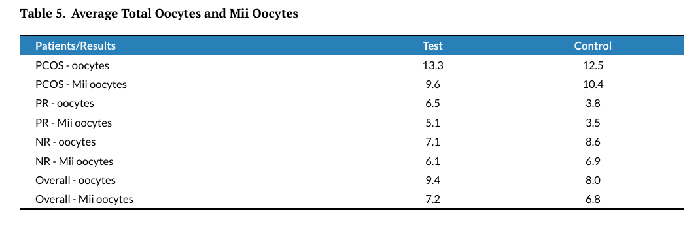
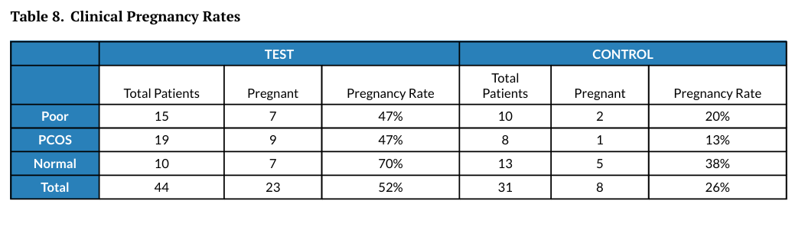
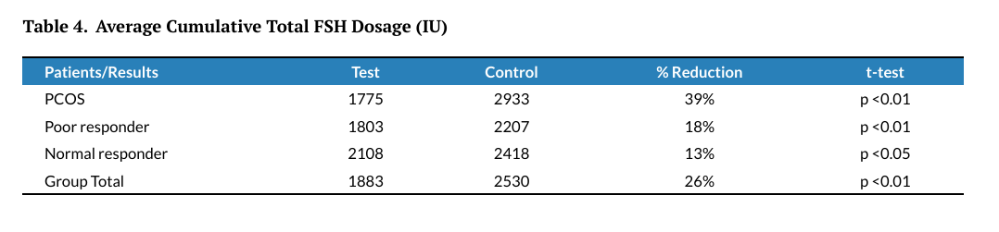
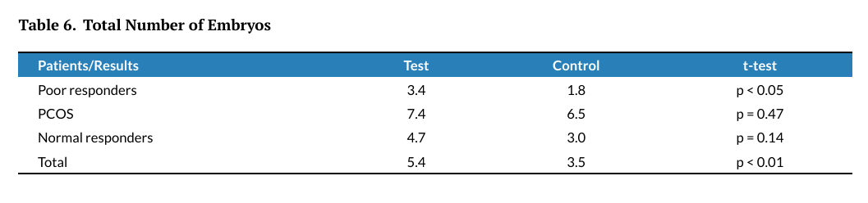
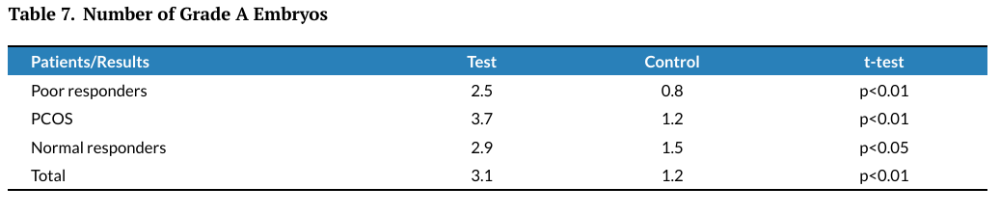
Results
36

Slide 39
Conclusion
01
02
03
04
The Opt-IVF clinical decision-support tool enables fully personalized hormone dosing throughout the IVF stimulation cycle using mathematical modeling and optimal control.
Use of Opt-IVF significantly reduced gonadotropin dosage and eliminated the need for ultrasounds after day 5, without compromising clinical outcomes.
The intervention group showed a higher number of total and high-quality embryos, as well as a significantly higher clinical pregnancy rate, particularly in poor responders and PCOS patients.
Opt-IVF represents a safe, efficient, and cost-effective approach, especially valuable for challenging patient populations and resource-limited settings.
37

Slide 40

Clinical decision support systems(CDSS)

